Slide 1
PFC PROMOTION WORKSHEET (as of 10 AUG 26)
Cadet Name (last, first): ________________________________________
Company: _______________
Task:
Recite the JROTC “Mission”
Recite the “Purpose” of JROTC
Recite the “Key to Success” in JROTC
Recite the “JROTC Creed”
Score 100% on Rank Test
Recite Company Chain of Command
Perform Basic Drill Movements
Demonstrates Proper Uniform Wear
All Forms Completed & Turned In
Date Completed:
________________
________________
________________
________________
________________
________________
________________
________________________________
Certified By (rank & name):
_________________________________________________________________________________________________________________________________________________________________________________________________________________________________
PSG:_________________________
1SG:________________________
CDR:_______________________
SAI / AI Verifies or Waives the Following: ______________________________________
Grade of 75% or Higher in JROTC
No ISS/OSS in 9 Week Period
No Missed Uniform Wears in 9 Week Period
No More than 1 Unexcused Absence in 9 Week Period
Instructor’s Endorsement Received with Favorable Recommendations

Slide 2

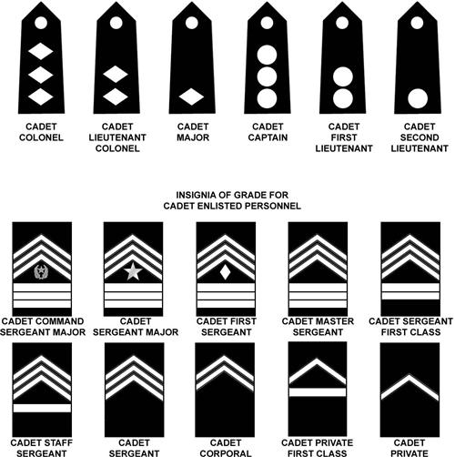
JROTC Creed
I am an Army Junior ROTC cadet.
I will always conduct myself to bring credit to my family, country, school and the Corps of Cadets.
I am loyal and patriotic.
I am the future of the United States of America.
I do not lie, cheat or steal and will always be accountable for my actions and deeds.
I will always practice good citizenship and patriotism.
I will work hard to improve my mind and strengthen my body.
I will seek the mantle of leadership and stand prepared to uphold the Constitution and the American way of life.
May God grant me the strength to always live by this creed.
Army JROTC
FOR ADDITIONAL RESOURCES, VISIT THE LENNARD JROTC WEBSITE!
MISSION: “To motivate young people to be better citizens.”
PURPOSE: “To help cadets graduate from high school.”
KEY TO SUCCESS: “Teamwork”
CIP: Continuous Improvement Plan
LET: Leadership Education and Training
INSIGNIA OF GRADE FOR CADET OFFICERS
JROTC Cadet Chain of Command
Company Commander: _____________________
Company First Sergeant: _____________________
Platoon Leader: _____________________
Platoon Sergeant: _____________________
Squad Leader: _____________________
Principal: _____________________
Senior Army Instructor: _____________________
Army Instructor: _____________________
INSIGNIA OF GRADE FOR CADET ENLISTED PERSONNEL

